Slide 1

Presentation Materials Created by Mimetics Inc.
Free use by anyone for non-commercial purposes
Copyrights, Trademarks and other Registered Marks the Property of their Owners

Slide 2
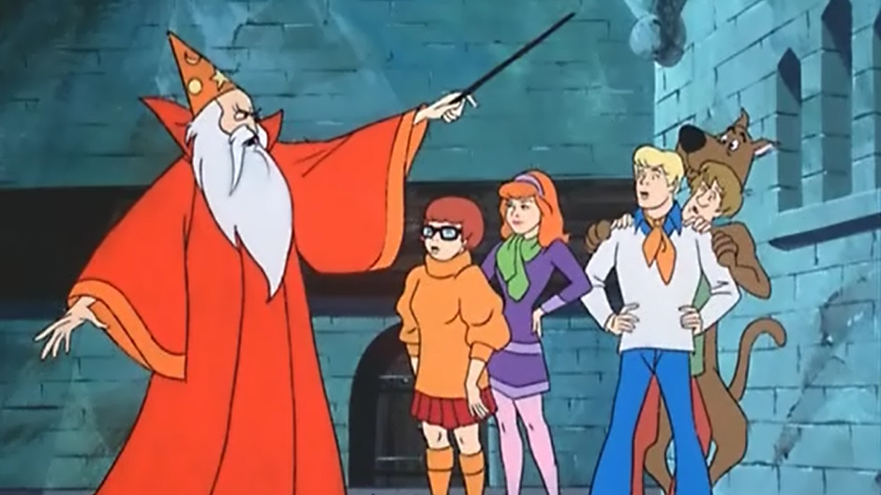
Grade 8 Systems
Class 6
MORE Comparisons
& Spectrometer Theory
Notes:
We want to introduce the Jade Robot and it’s Tools in more detail along with our action plans for it.
It’s interesting, but it’s easy to criticize something when it’s done (especially when you have experience) – a *LOT* more difficult getting it right from the start. Also, preparing this presentation was a great way to review and think about what we should be doing.

Slide 3
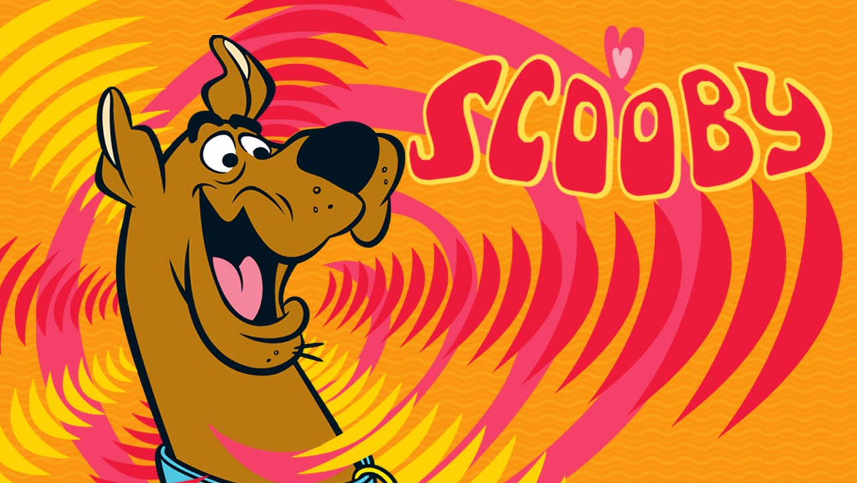
Recap
What is an if Statement?
What are the Number Ranges used for Sensors and Motors?
Notes:
Can Demo Jade Scratch if people are interested. In doing this product I’ve had a few interesting discoveries – one was going with a simpler programming language actually has a *LOT* of value for an expert like myself.

Slide 4
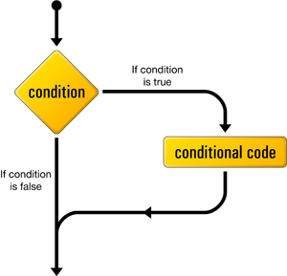
“if” Operations
Notes:
We clone a community project into “My Projects” so we can make changes to it without affecting all the “Community Projects”

Slide 5
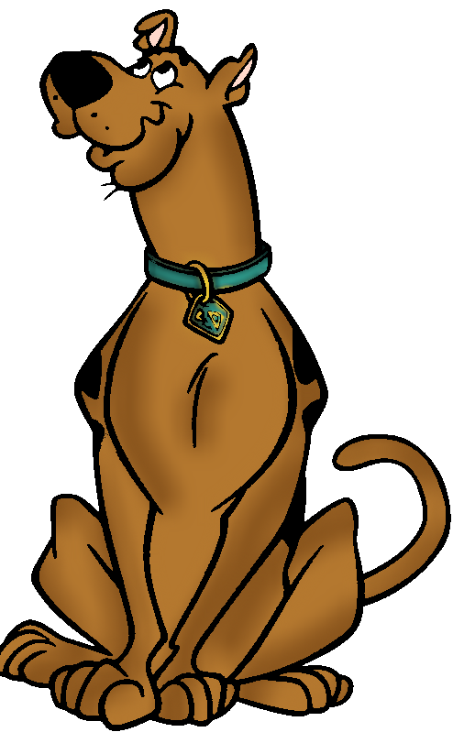
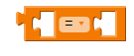
Comparison Operators
“Equals” is A = B
“Not Equals” is A ≠ B
“Less Than” is A < B
“Less Than or Equals” is A ≤ B
“Greater Than” is A > B
“Greater Than or Equals” is A ≥ B
Notes:
Can Demo Jade Scratch if people are interested. In doing this product I’ve had a few interesting discoveries – one was going with a simpler programming language actually has a *LOT* of value for an expert like myself.

Slide 6
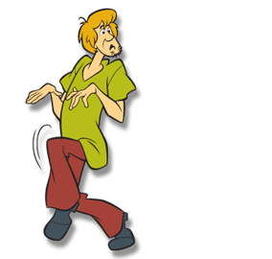
True & False
“True” is an Non-Zero Integer
“False” is Zero
Notes:
Can Demo Jade Scratch if people are interested. In doing this product I’ve had a few interesting discoveries – one was going with a simpler programming language actually has a *LOT* of value for an expert like myself.

Slide 7
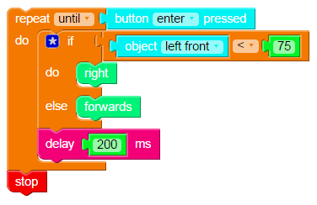
if2
Notes:
Can Demo Jade Scratch if people are interested. In doing this product I’ve had a few interesting discoveries – one was going with a simpler programming language actually has a *LOT* of value for an expert like myself.

Slide 8
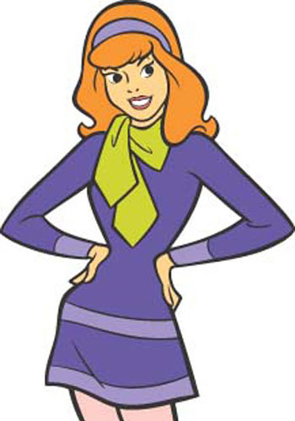
Repeat Challenge
Create a program that:
Repeat Until “Enter” Button Pressed
Draw Left & Right Front Object Values
if Left Front Object Sensor < 75
Turn Right for 200ms
else if Right Front Object Sensor < 75
Turn Left for 200ms
else
Go Forwards for 200ms
Notes:
Can Demo Jade Scratch if people are interested. In doing this product I’ve had a few interesting discoveries – one was going with a simpler programming language actually has a *LOT* of value for an expert like myself.

Slide 9
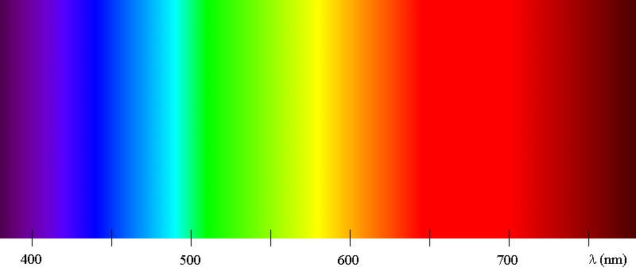
Spectrometer Theory
Sun/White light is a Spectrum of Colours/Wavelengths
Notes:
Can Demo Jade Scratch if people are interested. In doing this product I’ve had a few interesting discoveries – one was going with a simpler programming language actually has a *LOT* of value for an expert like myself.

Slide 10
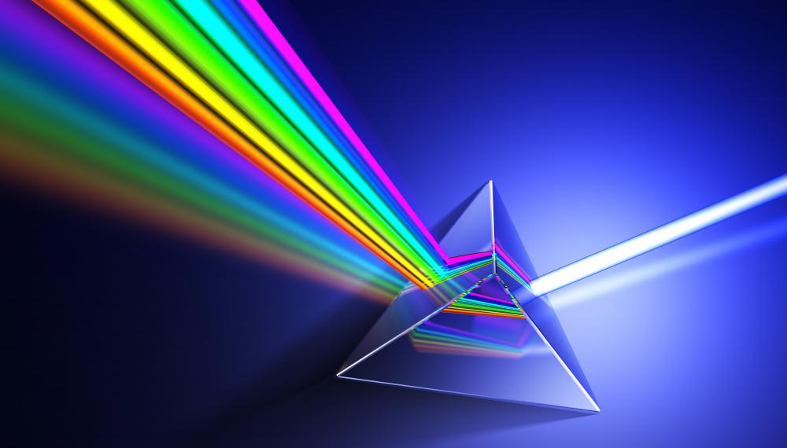
Prisms will Break
Light Out into its
Spectrum
Notes:
Can Demo Jade Scratch if people are interested. In doing this product I’ve had a few interesting discoveries – one was going with a simpler programming language actually has a *LOT* of value for an expert like myself.

Slide 11

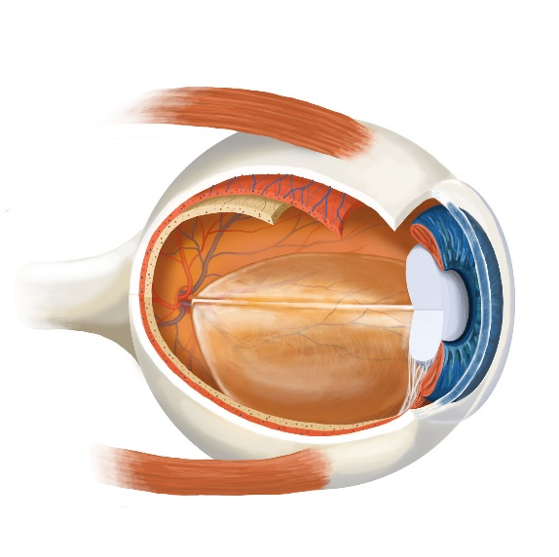
Spectrometer Theory
The “colour” of an object is light that bounces off it
White Light from Sun
Just Blue Light Reflected
Notes:
Can Demo Jade Scratch if people are interested. In doing this product I’ve had a few interesting discoveries – one was going with a simpler programming language actually has a *LOT* of value for an expert like myself.

Slide 12
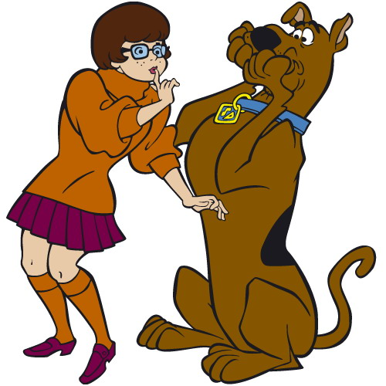
Query
What is the colour of an object when one Colour, NOT a Spectrum of Light is Applied To it?
Notes:
Can Demo Jade Scratch if people are interested. In doing this product I’ve had a few interesting discoveries – one was going with a simpler programming language actually has a *LOT* of value for an expert like myself.

Slide 13
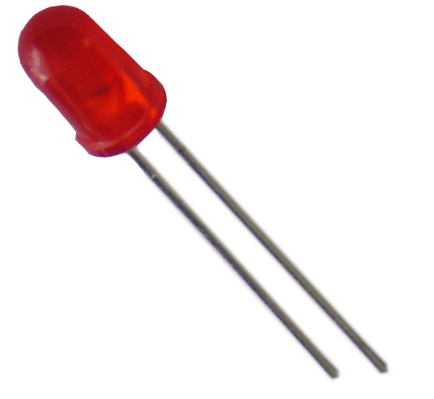
Spectrometer Theory
The “colour” of an object is light that bounces off it
Red Light
What Colour do you see?
Notes:
Can Demo Jade Scratch if people are interested. In doing this product I’ve had a few interesting discoveries – one was going with a simpler programming language actually has a *LOT* of value for an expert like myself.

Slide 14
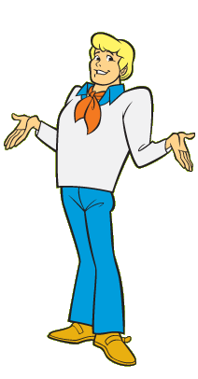
Spectrometer Theory
If we only had some way to do an Experiment…
Notes:
Can Demo Jade Scratch if people are interested. In doing this product I’ve had a few interesting discoveries – one was going with a simpler programming language actually has a *LOT* of value for an expert like myself.

Slide 15
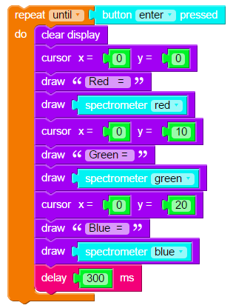
Spectro1
Run “Spectro1” and use it to measure the light reflected for each of the three Colours on Different Coloured sheets of Paper
Notes:
Can Demo Jade Scratch if people are interested. In doing this product I’ve had a few interesting discoveries – one was going with a simpler programming language actually has a *LOT* of value for an expert like myself.

Slide 16
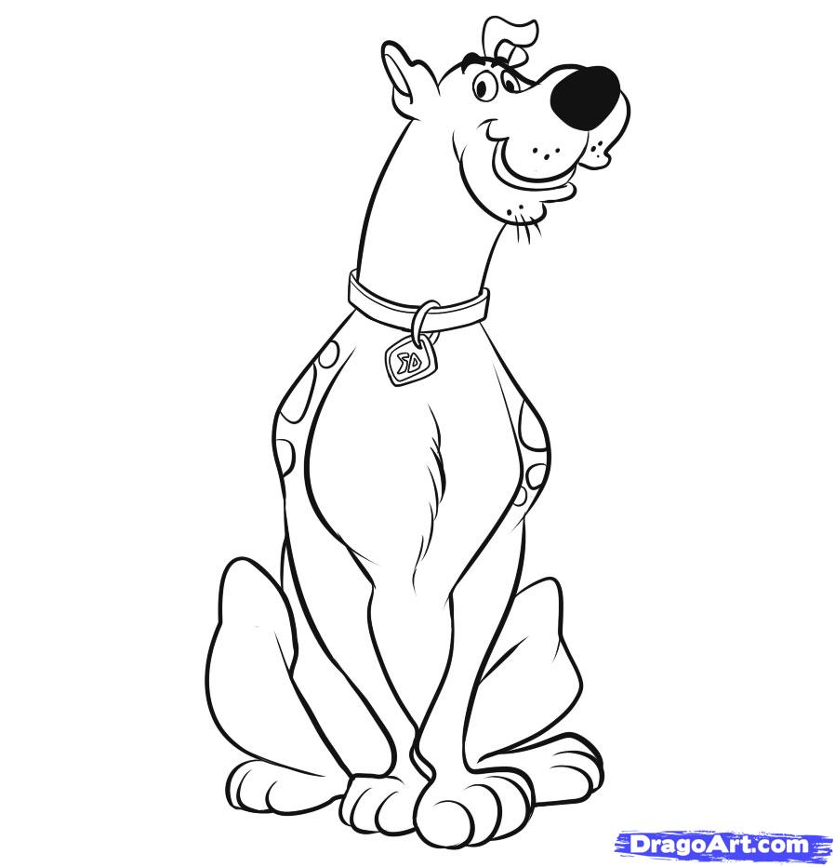
Spectrometer Theory
What is the relationship of the Spectrometer Colour Value to the Colour of the Paper?
Notes:
Can Demo Jade Scratch if people are interested. In doing this product I’ve had a few interesting discoveries – one was going with a simpler programming language actually has a *LOT* of value for an expert like myself.

Slide 17
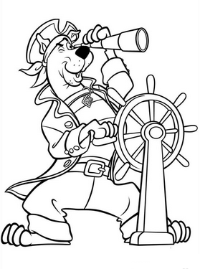
Spectrometer Theory
If the Colour of Light Applied is Different from the Surface Colour, No Light is returned
To your Eye, it Appears Black
Notes:
Can Demo Jade Scratch if people are interested. In doing this product I’ve had a few interesting discoveries – one was going with a simpler programming language actually has a *LOT* of value for an expert like myself.

Slide 18
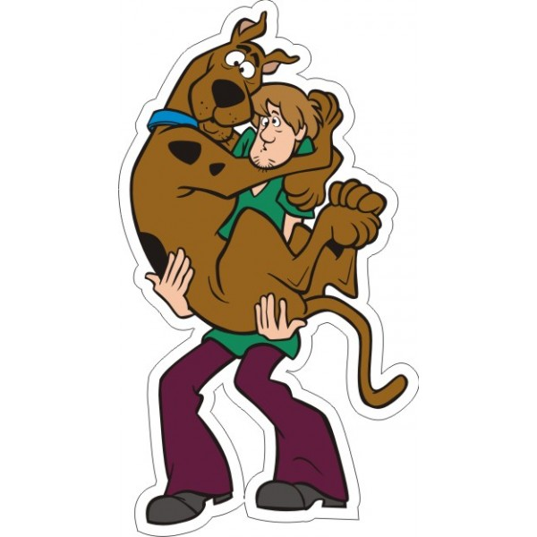
Class Challenge
Create a Program in Which the Robot Goes
Forwards on a Coloured Piece of Paper BUT
Stops Moving when it is NO LONGER Over It
Notes:
Can Demo Jade Scratch if people are interested. In doing this product I’ve had a few interesting discoveries – one was going with a simpler programming language actually has a *LOT* of value for an expert like myself.

